Slide 1


Domino’s Pizza Sales Analysis Using SQL
Exploring Data-Driven Insights into Pizza Sales Performance
Name : Debdatta Mukherjee
Date : October 2025

Slide 2
Project Overview:
This project demonstrates SQL techniques to explore, clean, and analyze pizza sales and customer data. The analysis focuses on understanding order patterns, revenue, and menu performance to support business decision-making.
Objectives:
Set up a Domino’s pizza database: Create and populate the database with orders, pizzas, and customers.
Data Cleaning: Identify and remove null or inconsistent records.
Exploratory Data Analysis (EDA): Understand customer behavior, order trends, and menu performance.
Business Analysis: Answer stakeholder-driven questions to derive actionable insights.

Slide 3
Database Structure:
Tables:
orders: Contains order-level information (order_id, custId, order_date, order_time).
order_details: Contains details of each order (order_detail_id, order_id, pizza_id, quantity).
pizzas: Contains pizza information (pizza_id, pizza_type_id, size, price).
pizza_types: Contains pizza type info (pizza_type_id, name, category).
customers: Contains customer info (custId, first_name, last_name).
Data explorations and techniques:
Verify total records in each table.
Check for null or missing values in critical columns.
The data was cleaned and prepared by modifying column data type and validating record counts.
Techniques Used: Aggregations, Joins, CTEs, Window Functions, Ranking Functions, and Date-Time Functions.

Slide 4
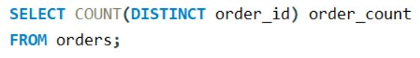
Order Volume Analysis
Total Unique Orders:
Monthly Trends: SQL window functions (LAG()) were used to find month-over-month (MoM).
→ Insight: Orders show significant seasonal variation, indicating peak months around festive or promotional periods.
Day-wise Order Distribution: Using DAYNAME(order_date)
shows that weekends (especially Friday and Saturday) record the highest order volumes — suggesting stronger weekend sales patterns.
Order Timing Trends (Hourly Analysis): HOUR(order_time)
reveals order peaks between 6 PM – 9 PM, aligning with dinner hours.
Average Pizzas Ordered per Day
Metric: Average daily pizza demand = AVG(daily_total)
Insight: Provides consistency tracking of daily performance and inventory needs.

Slide 5
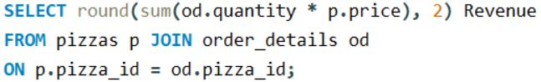
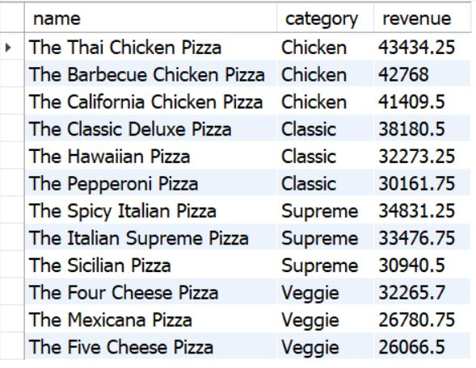
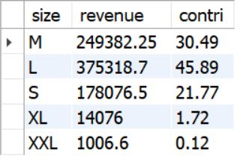
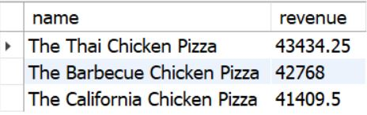
Revenue Analysis
Total Revenue: 817860.05
Top 3 Pizzas by category (Revenue based)
Revenue Distribution by Pizza Size:
Top 3 Pizzas by Revenue:
Cumulative Revenue Trend
Finding: A steady upward trend with noticeable spikes in festive
or promotional periods.

Slide 6
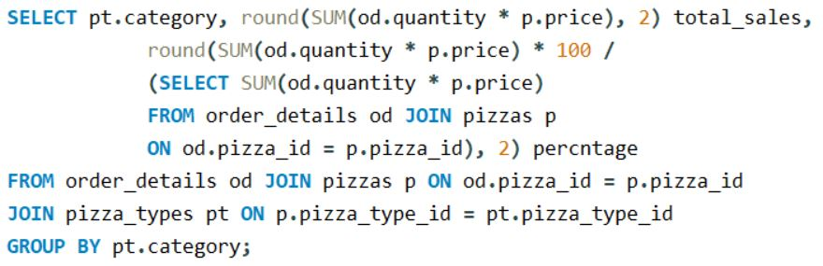
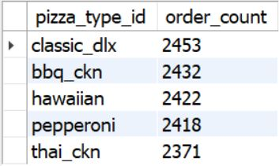
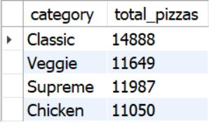
Product & Menu Analysis
Category-wise pizza distribution
Most Common Pizza Size Ordered
Finding: Medium (M) and Large (L)
sizes are most frequently ordered.
Highest-Priced Pizza
Identified using an ORDER BY price DESC query.
Insight: Premium large-size pizzas (especially from the “Supreme” and “Classic” categories) dominate the top pricing tier.
Top 5 Most Ordered Pizza Types
Total quantity by pizza category

Slide 7
Key Business Recommendations:
Focus Promotions on Peak Hours: Target advertising and discounts during 6–9 PM.
Inventory Planning: Prioritize medium and large pizza stock levels.
Product Strategy: Promote high-margin “Deluxe” and “Supreme” categories.
Seasonal Campaigns: Leverage months with historical order spikes for promotional campaigns.
Customer Retention: Reward loyal customers who order repeatedly from top-selling pizza types.
Conclusion:
This SQL-based analysis of Domino’s Pizza sales provides valuable insights into ordering behaviour, product performance, and revenue distribution. By leveraging data-driven findings, Domino’s can refine its sales strategies, optimize operations, and enhance customer satisfaction.

